Slide 1


Slide 2
Microsoft Search
What’s new and what’s next
Bill Baer @williambaer
Kathrine Hammervold @nonstopkat
Kerem Yuceturk
Roseanne Levasseur

Slide 3
BRK113
What's new and what's next: Microsoft Search
Get the latest updates on Microsoft Search. Come on the journey to learn how insights, actions and answers are being built into your everyday experiences across Microsoft 365. See the latest roadmap on Microsoft Search across all your experiences, from SharePoint to Office, and including external 3rd party content connectors and extensibility.
SharePoint Conference 2019 Link to session here [ https://www.sharepointconference.com/#!/session/What's%20new%20and%20what's%20next:%20Microsoft%20Search/3780 ]
Date [ May 21st, 2019 ] Time [ 14:30 – 15:30 ] Room [ Microsoft A ]
Speakers [ Bill Baer, Kathrine Hammervold ]

Slide 4

“The most profound technologies are those that disappear. They weave themselves into the fabric of everyday life until they are indistinguishable from it.”
Mark Weiser

Slide 5
We all struggle finding information…
“
I need to find the most current industry research data for this client proposal.
Can you send me the link to the PowerPoint you presented yesterday?
Where did I put that spreadsheet for the sales call?
Hang on, I think it’s on my hard drive…or was it OneDrive? Maybe it’s on SharePoint instead?”
I can’t find our health insurance claim form.
“
Where did I put that document I was working on?
Where did I put that spreadsheet for the sales call?
I need directions to Building 34 for tomorrow’s meeting.

Slide 6
Why?
Inundated by too much data and content
Searching at work is frustrating
Our expectations have changed

Slide 7

How much is too much?
44
zettabytes of data by 2020
76%
of data is unstructured
Stored in multiple locations:
Company intranets
Cloud services
SharePoint
OneDrive
Line of business applications
On-premises servers
¹ IDC The Digital Universe of Opportunities: Rich Data and the Increasing Value of the Internet of Things
² Deloitte Oveview of emerging technologies

Slide 8
Why is searching at work frustrating?
We are faced with multiple, distinct search experiences:
Context and application-switching to find information
Each entry point has a different search UX
Results are partial, and inconsistent across applications
and there are just too many results to dig through to find the right one.

Slide 9
Our expectations have changed…
We want searching at work to be as easy as searching the web.
We want results that are relevant and personalized.
We want answers to our questions, not just more links.

Slide 10
As a result…
20%
of our time at work is spent just looking for information.
That’s 1 day a week lost per employee!
No wonder companies have spent billions of dollars building custom solutions to try and solve this problem.
¹ McKinsey Global Institute The social economy: Unlocking value and productivity through social technologies

Slide 11
Introducing Microsoft Search
Intelligent search for the modern workplace

Slide 12


Slide 13

Microsoft Search
in Bing
in Office.com
in SharePoint
in Edge
in Windows
One capability.
Every search experience.
in PowerPoint
in Outlook
in OneDrive
in Stream
in Yammer
in Word
in Teams
in OneNote
Microsoft Graph + Bing technology

Slide 14





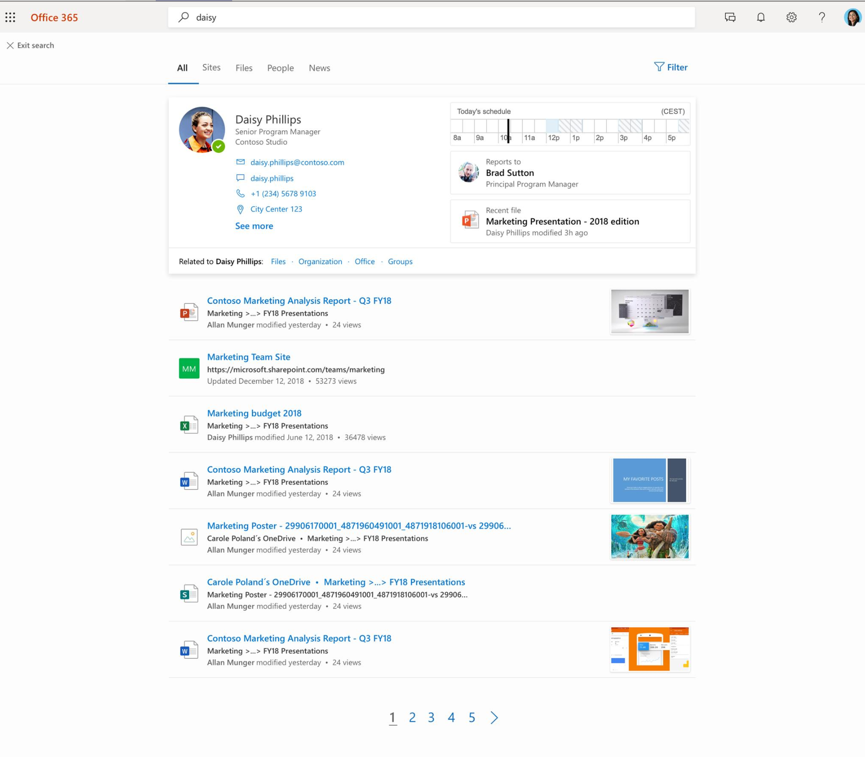
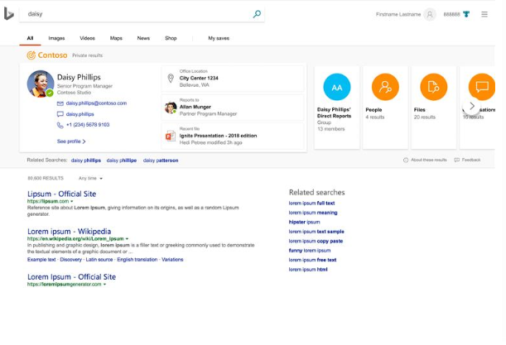
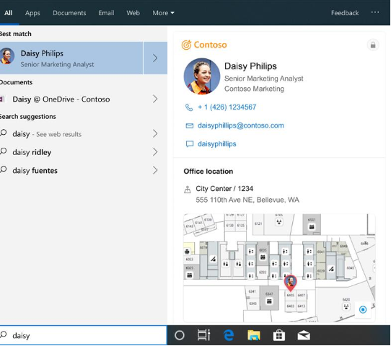
Microsoft Search announcement
Microsoft Search is now rolling out to customers …
in SharePoint Start Page
in SharePoint sites
in OneDrive
in Office.com
in Outlook web
in Word, Excel and PowerPoint desktop
in Bing
and coming to Windows in Summer 2019
Learn more at aka.ms/MicrosoftSearch/Blog/SPC19
Berit will provide illustration today (5/21)

Slide 15



Microsoft Search for your organization
Part of your O365 and M365 subscription
Available everywhere
Trustworthy
Increases productivity from day one
Unified Administration
Customized for your business
Empowering the ecosystem

Slide 16
Microsoft Search features
Built on the Microsoft Graph and using Bing technology, Microsoft Search gives your employees the ability to easily find:
Files: Contextual and relevant files on SharePoint, OneDrive for Business, and more
People: Someone’s role within the company, what they’ve been working on, org charts, and ways to contact them – even when you search by their nickname
Conversations: Relevant topics in Microsoft Teams and Yammer chats
Sites, answers and resources: Curated bookmarks help them navigate quickly to internal sites and tools, while Q&A’s give them quick answers without additional clicks
Groups: Office 365 groups by name or by members, then browse shared content
Locations: Addresses, maps, and directions to company buildings

Slide 17
Microsoft Search in SharePoint & OneDrive

Slide 18
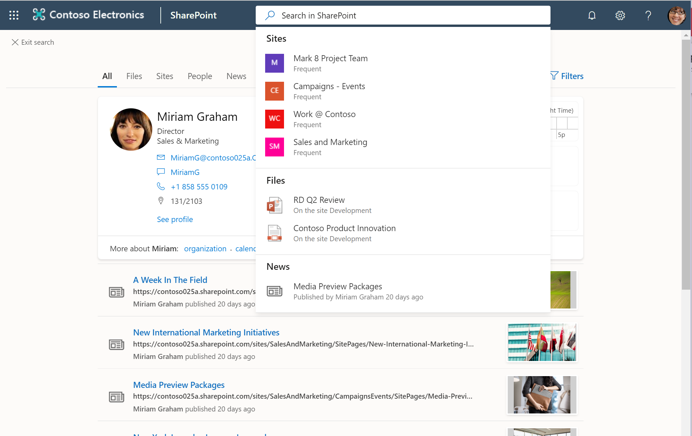
Microsoft Search in OneDrive & SharePoint Find what you need, where you’re working
Zero-query suggestions personalized for the current user
Personalized people results with improved people answer cards
Bookmarks to internal sites and tools
Building locations
Q&As for work-related questions
Rolling out to modern OneDrive and SharePoint experiences. Classic sites will be able to participate later this year.

Slide 19
Microsoft Search in Office

Slide 20
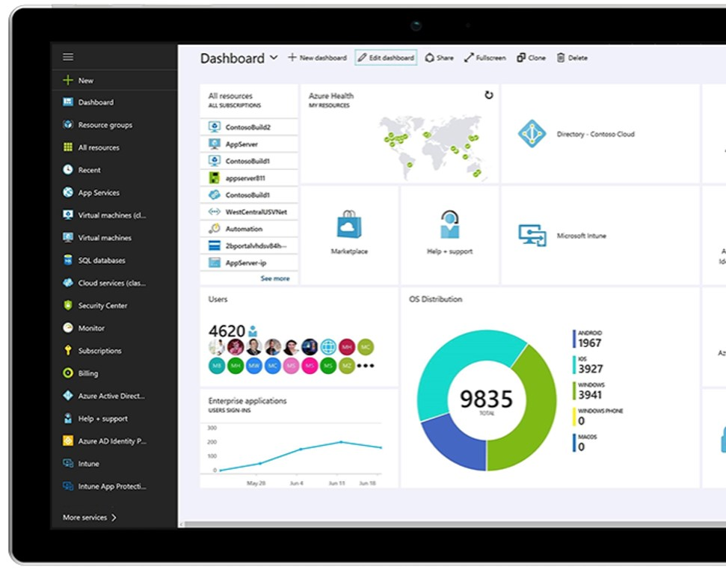
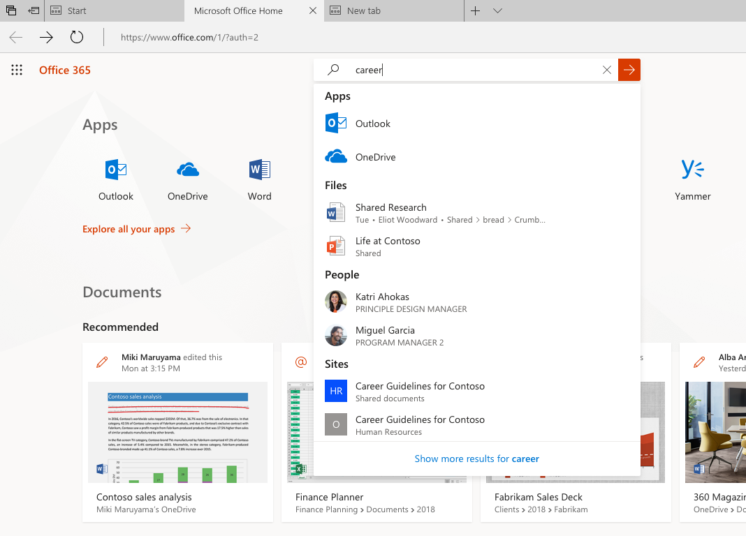
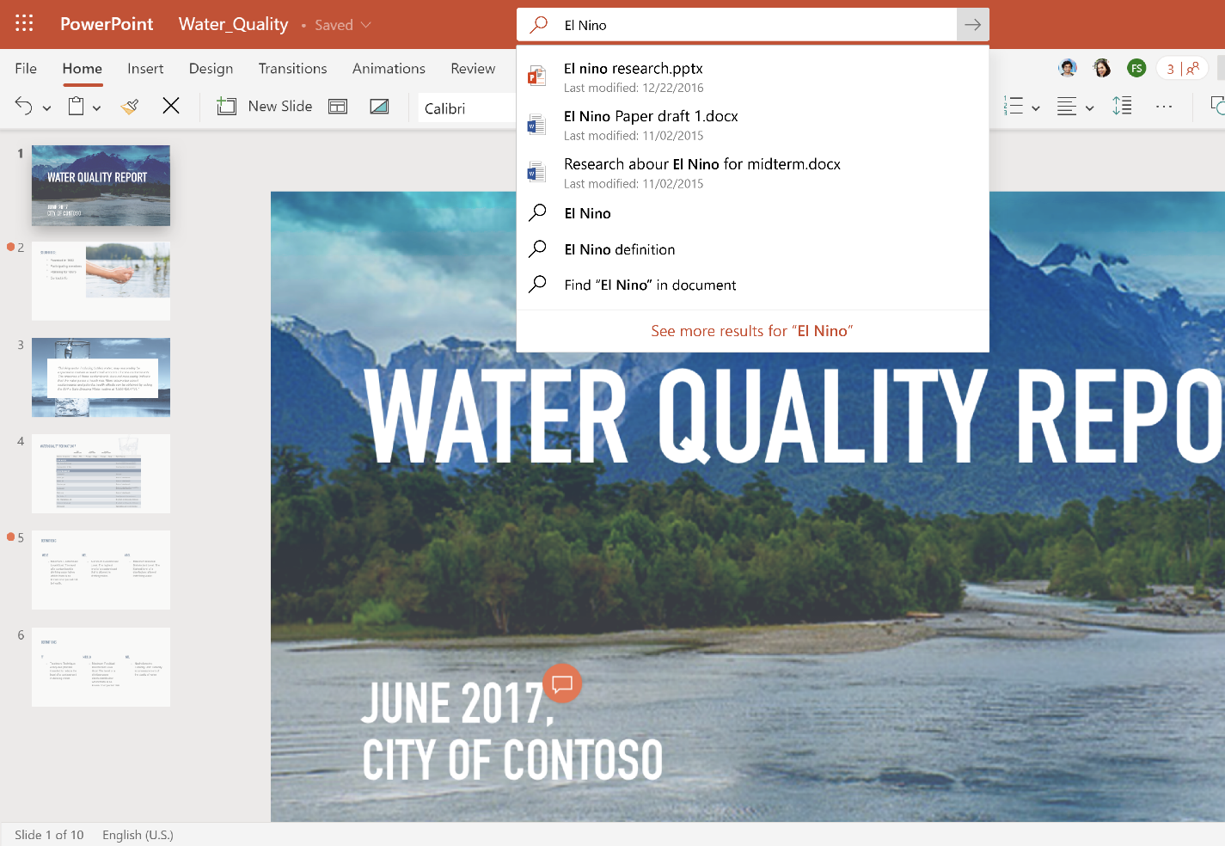
Microsoft Search in Office Find and get back to your work faster
Find apps from your organization, content, people, and sites
Bring the power of Office and the web to you in the app, without needing to switch apps
Delivers relevant results across all of Office, including Word, Excel, and PowerPoint
Find actions, services, and content that help you complete your task

Slide 21
Microsoft Search on mobile

Slide 22
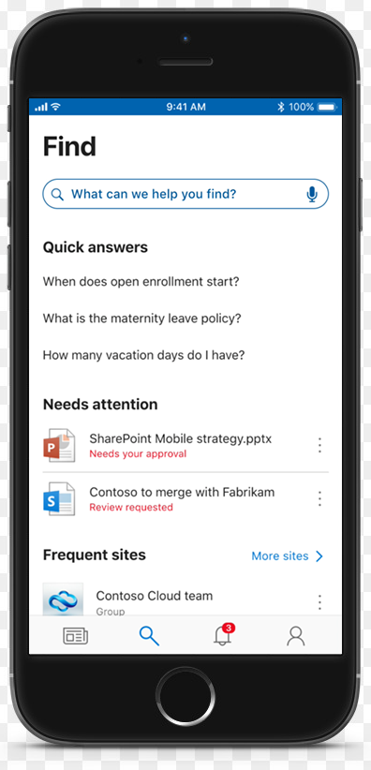

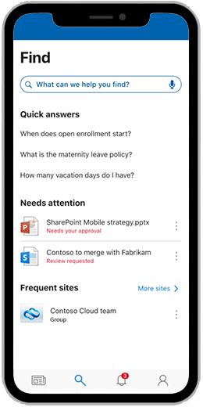
Microsoft Search in the SharePoint mobile app Tap your organization’s knowledge
New Find tab for streamlined experience―collapses sites, links, people, and search into single view
Shows common questions, personalized results, search history, and frequent searches that organizations can curate
Gives quick access to recent sites and people you work with

Slide 23
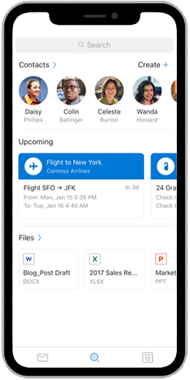
Microsoft Search in Outlook Search you can depend on in Outlook – on any platform
Find the right item faster with top relevant results, quick result suggestions, and proactive recommendations
Increase search success with guided suggestions and better intent understanding (spelling correction, implied filtering, etc.)
Search with confidence beyond email across your calendar, people, attachments, and links

Slide 24
Microsoft Search in Bing and Windows

Slide 25
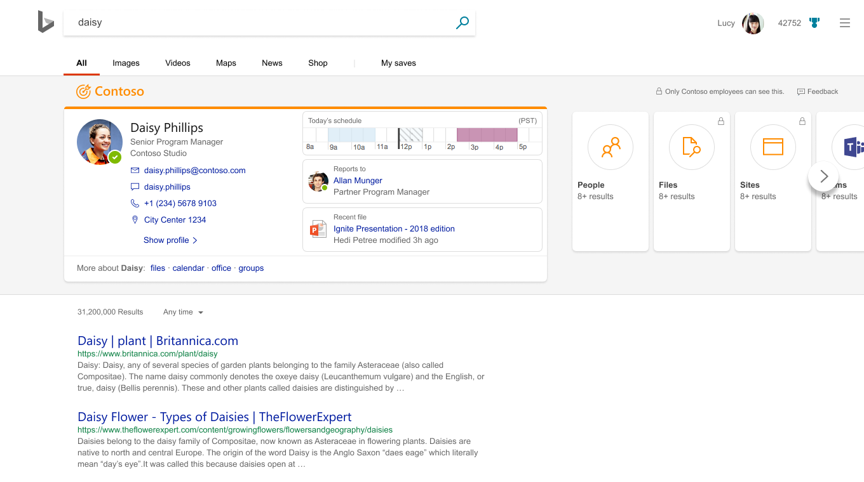
Microsoft Search in Bing Find work results as simple as a web search
Get same results across SharePoint, Office, and Bing including:
Search for people and conversations within your company
Search for files and groups across Microsoft connected services
Search for bookmarks to internal sites and tools
Search for building locations and direction within organization
Search for Q&As for work-related questions

Slide 26
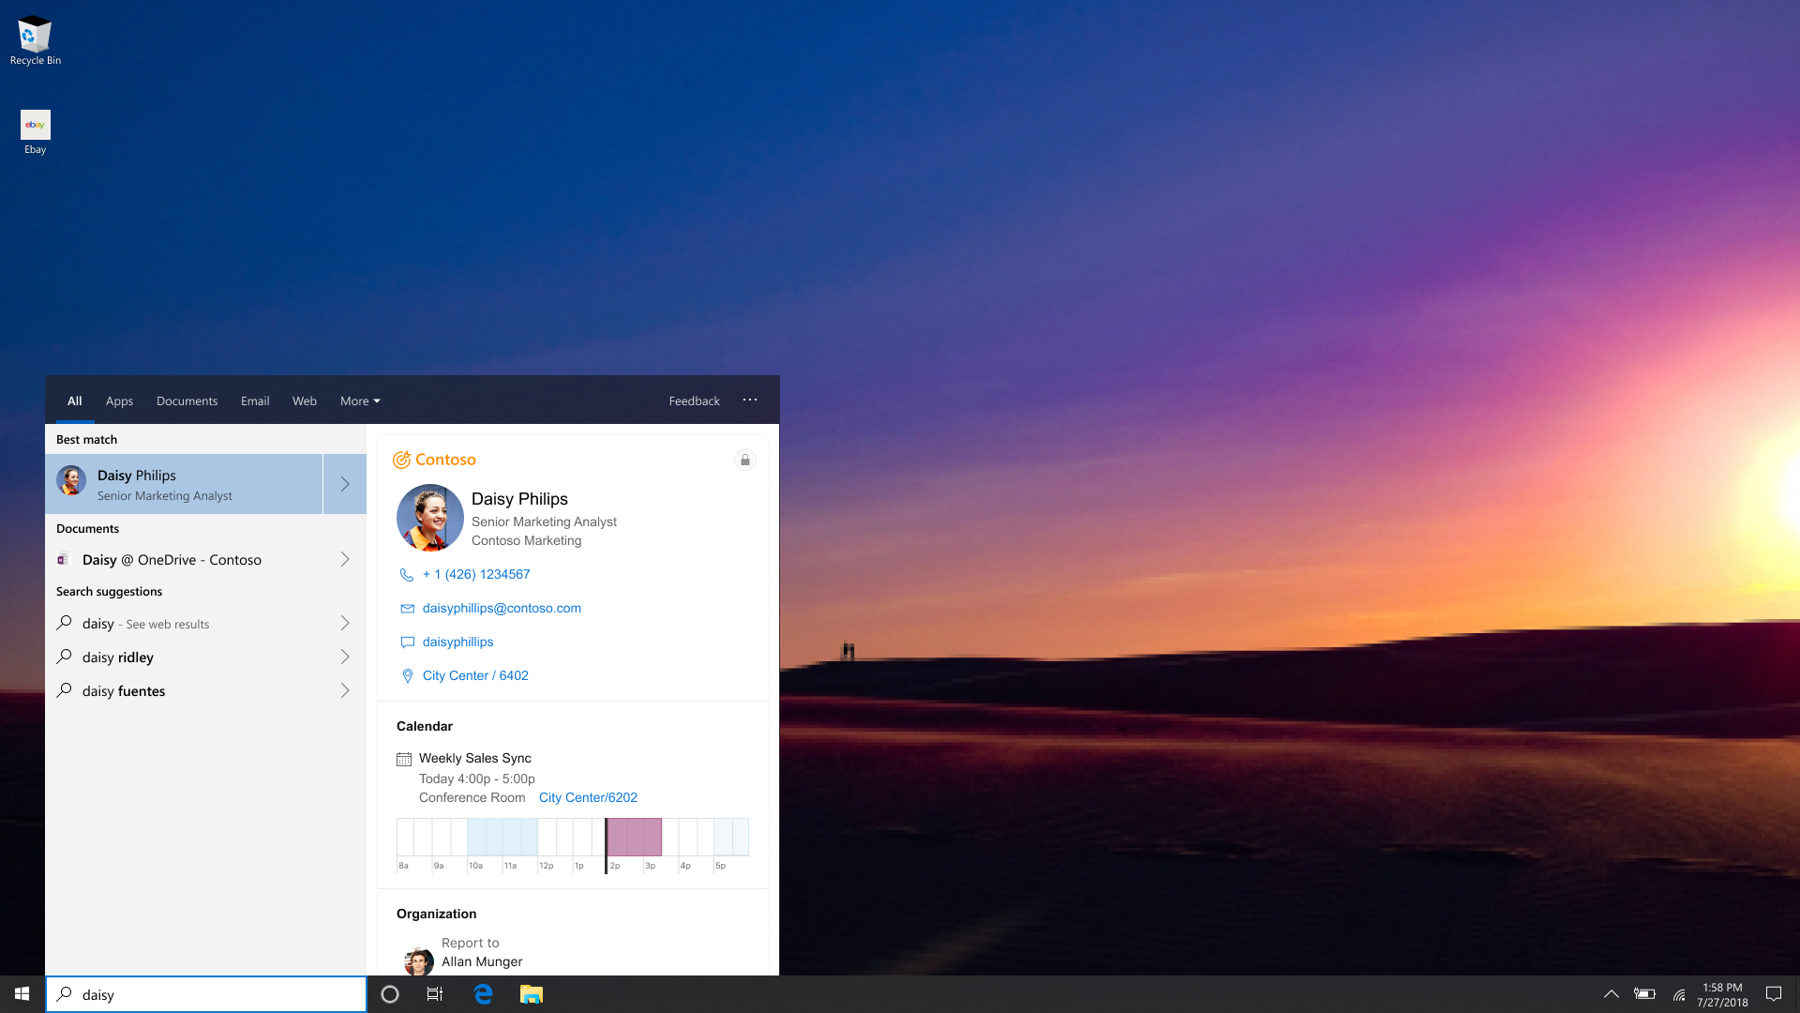
Microsoft Search in Windows Your organization’s knowledge, right from your desktop
Get answers right from the search bar across local, organization, and web content
Collective knowledge from your organization
Search Windows and the web to find people, files, apps, and locations with the same experience

Slide 27
Customization, Connectors, and Administration

Slide 28
Administration, Customization and Connectors
Unified Administration
Customized for your business
Empowering the ecosystem
A single, purpose-built enterprise search tool to replace multiple solutions
Manage search via a central console and monitor search usage and health via analytics
Take recommended actions to improve search experience and manage security & privacy settings centrally
Manage how and when knowledge reaches your employees, ensuring that important information and IP can be found by everyone
Create search-driven portals with relevant content, verticals and refiners
Customize display of results through adaptive cards
Out-of-the box Graph connectors to content stores, with APIs to build new ones or directly ingest content for search
Connecting 3rd party data & signals to the Microsoft Graph
Manage access control easily. Reflects permissions from source systems
Leverage open source web parts to build custom search pages using SPFX and its dev chain

Slide 29
Roadmap: Microsoft Search
Available Now*
Later this year
In Targeted Release
SharePoint & OneDrive
Suggestions as-you-type
Personalized results
Improved people search
Instant Answers (Bookmarks, Q&A and Locations)
OneDrive will get the unified search box with zero-query suggestions
Modern Document Libraries, Lists with controls to up-scope to the site, hub, or the whole company
Office Applications
Microsoft Search in Word, Excel, and PowerPoint desktop apps
Web
Microsoft Search in Bing
Admin
Manage bookmarks, Q&A and Locations in a central admin experience
Analytics for Microsoft Search in Bing
Microsoft Search API in Graph (Beta)
Microsoft Search in Windows
Office Applications
Microsoft Search in Word, Excel, and PowerPoint web apps
Microsoft Search in Teams
Connectors (Preview)
Out of the box connectors
Ingestion API for any content
Security trimming based on Azure AD
Video (including Stream) vertical
Conversations vertical in SharePoint and Office.com
Bookmarks and Q&A as-you-type in the search box
SharePoint
Redirect search to a custom page, use open-source PnP search web parts, or build your own using Graph and Search APIs
Classic sites can upgrade to modern search
Custom refiners, verticals, result types with modern display templates
OneDrive searches across all files
Admin
Additional health and analytics
Microsoft Search API in Graph improvements and GA

Slide 30



Action plan
Learn
Learn more about Microsoft Search and how to get started with intelligent search and discovery at https://aka.ms/MicrosoftSearch
Get Started
Learn more on how to get started with Microsoft Search at https://docs.microsoft.com/en-us/microsoftsearch/.
Use
Learn how to make the most of the knowledge of your organization and your users to make it easy for to find relevant content at https://docs.microsoft.com/en-us/microsoftsearch/make-content-easy-to-find.

Slide 31

Thank you

Slide 32
Thank you
Questions
Join the Microsoft Search Community | Give feedback on UserVoice | Follow us on Twitter @MicrosoftSearch
aka.ms/SPC/Sessions/BRK113 | Share slides and resources from this session
aka.ms/SPC/Sessions/BRK143 | Learn more from related sessions at SPC19
aka.ms/MicrosoftSearch/Resources | Explore resources for deployment and adoption
aka.ms/MicrosoftSearch/Blog | Stay up to date on the latest product news
aka.ms/MicrosoftSearch/Blog/SPC19 | Review the news and announcements from SPC19
aka.ms/MicrosoftSearch/Community | Join the conversation in the Microsoft Technical Community
aka.ms/MicrosoftSearch/Feedback | Give us feedback and input to shape the future
aka.ms/M365Roadmap | Discover what’s coming with the Microsoft 365 Roadmap
@williambaer @nonstopkat #SPC19 #BRK113 | Follow me and share this session

